Slide 1
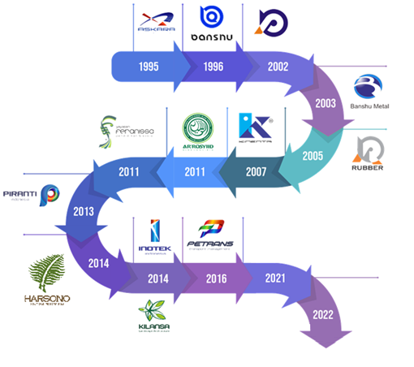
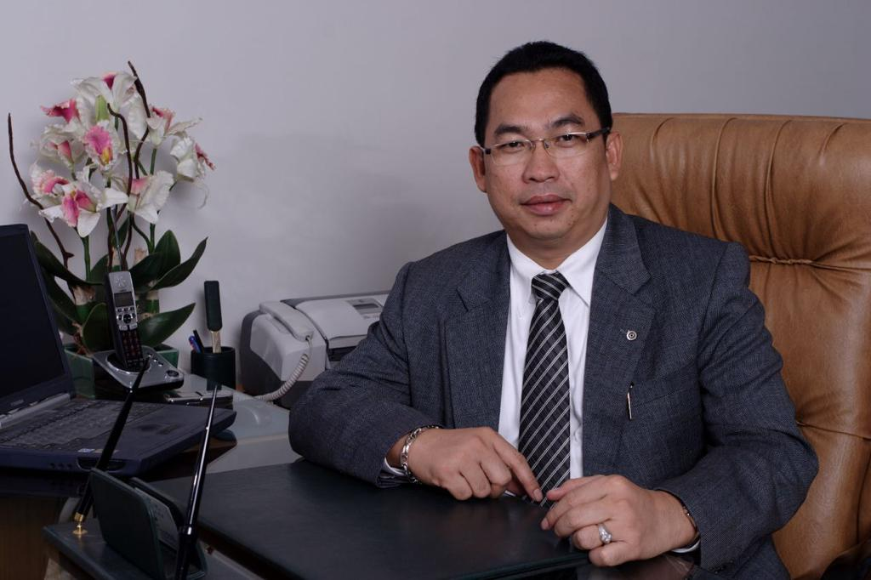
Askara Group Journey
PT Askara Internal
One Stop Solution Business Provider
PT Banshu Electric Indonesia (J.V. Company)
Wiring Harness Manufacture
PT Banshu Plastic Indonesia
Plastic Part Manufacture
PT Banshu Metal Indonesia
Metal Stamping Part Manufacture
PT Banshu Rubber Indonesia
Rubber Part Manufacture
PT Kinenta Indonesia
Wiring Harness Manufacture
PT Piranti Teknik Indonesia
Wiring Harness Manufacture
Banshu
Automotive
Component
PT Kinenta Lanscape Indonesia
Architect and constructor
Founded and Owner Of ASKARA Group – Owned By Deddy Harsono
PT Inotek Indonesia
Construction & Building maintenance
Elcon Banshu Wiring System
India
PT Persada Transport Indonesia
Logistic & Transport Management
PT Harsono Property Indonesia
Feranissa Foundation
Education & Social Program
PT Harsono Property Indonesia
Harsono Boutique Resort Bali
Resort & Villa
Elcon Banshu Wiring System Ltd - India
Wiring Harness Manufacture

Slide 2
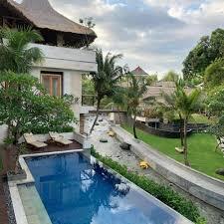
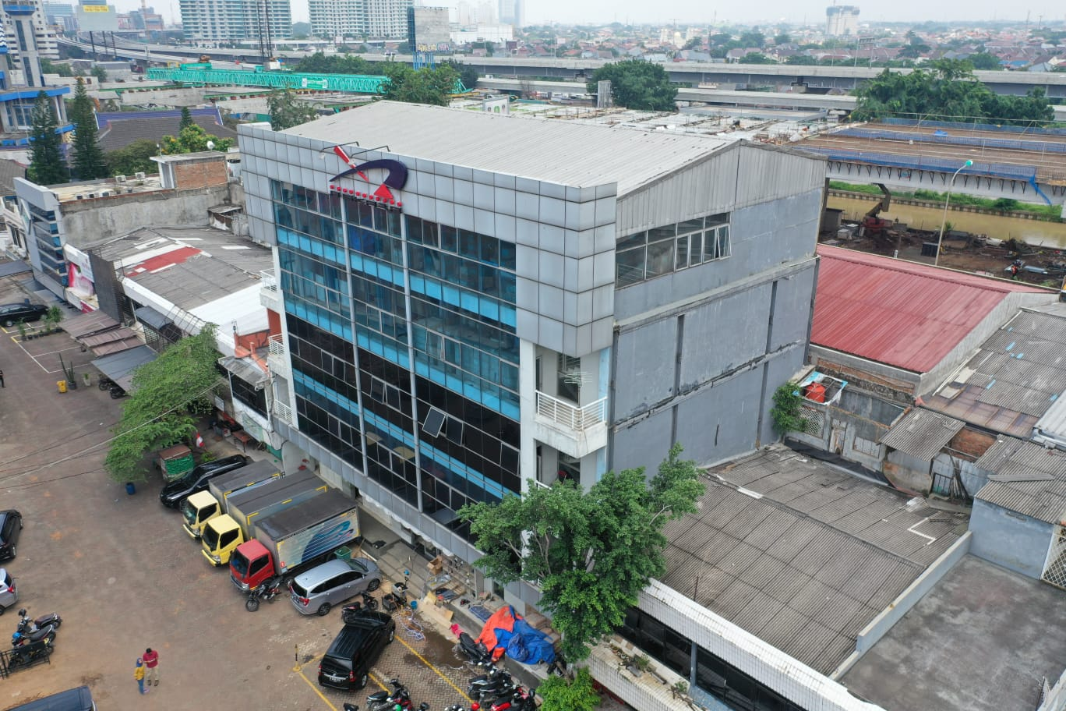
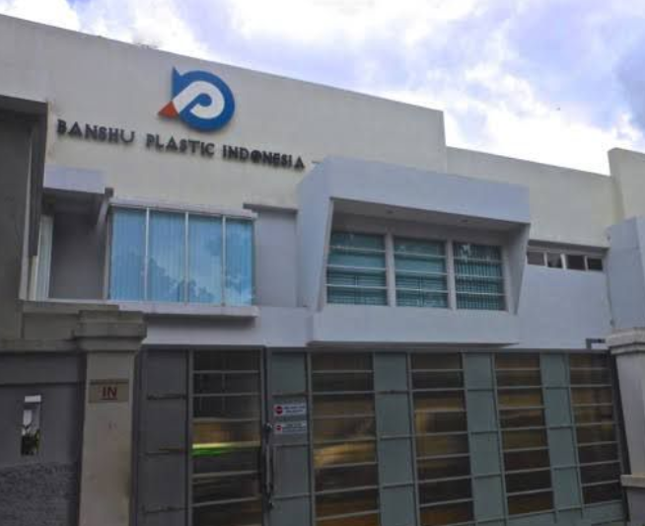

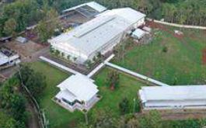
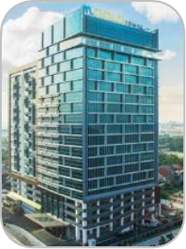

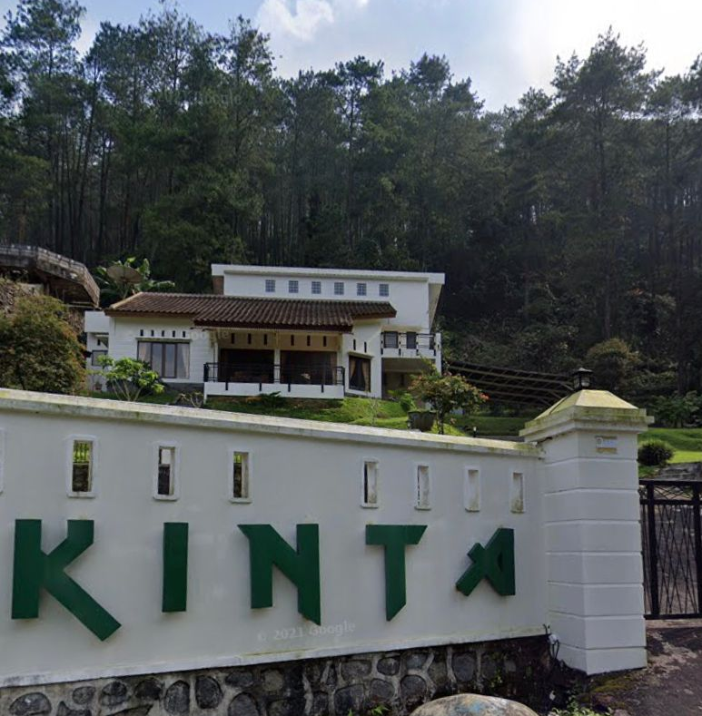




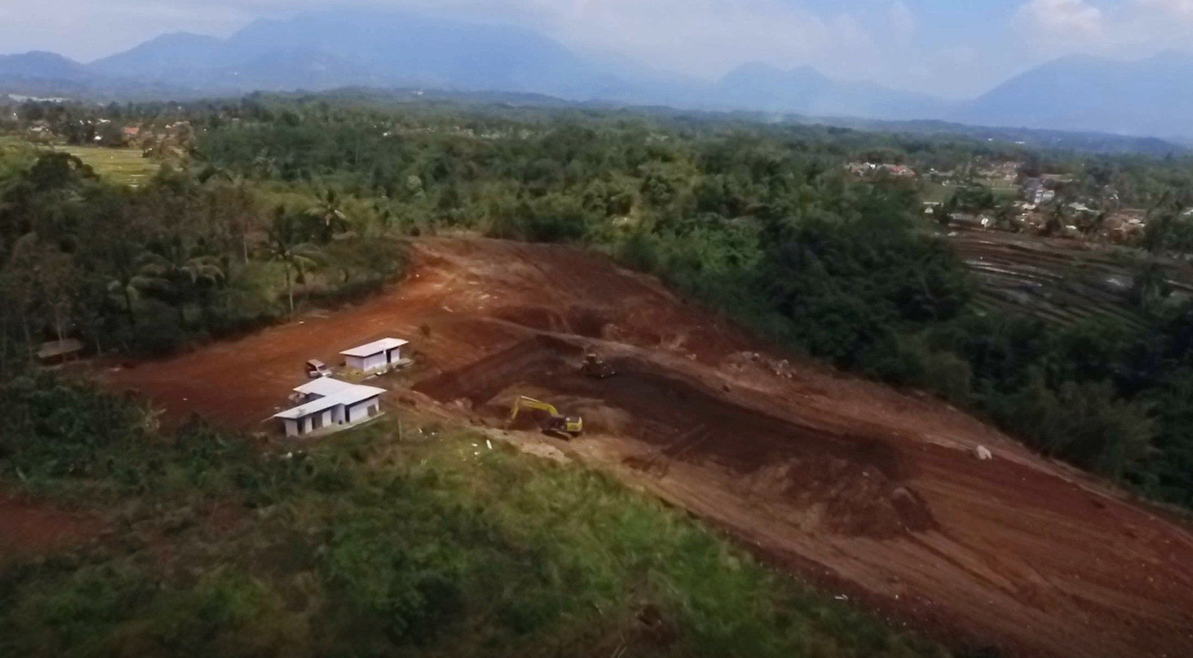
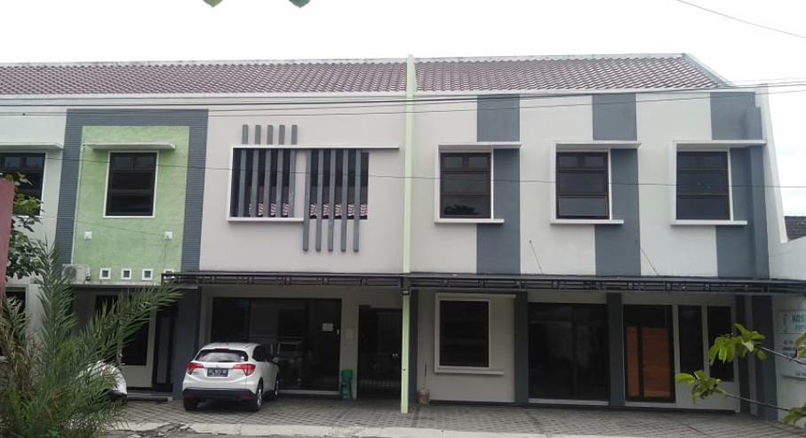
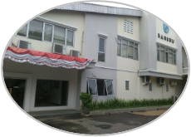
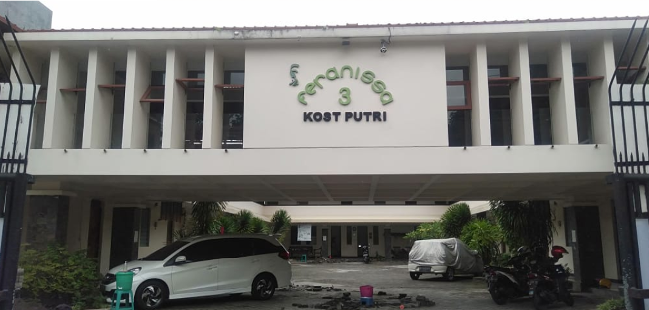
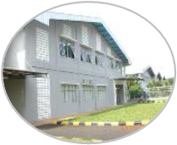
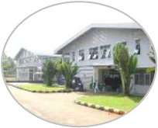

Askara Group Location
Head Office :
M-GOLD Tower FL. 18
JL. KH. NOER ALI, BEKASI, Jawa Barat – Indonesia
PT Askara Internal
Bekasi,
Jawa Barat – Indonesia
Video
Factory Plant 3
Industrial Zone TEXMACO
Subang - Jawa Barat
Indonesia
PT Piranti Teknik Indonesia
Industrial Zone Gn. Sari
Pagaden Subang
Jawa Barat - Indonesia
Video
PT Banshu Plastic Indonesia
Cikarang Bekasi
Jawa Barat - Indonesia
Harsono Boutique Resort
BALI -
Video.
BEKASI
JABABEKA
Villa Kinta
Cisarua, Bogor
Bogor
Jawa Barat
SUBANG
PURWAKARTA
Jawa Tengah
GARUT
NEW FACTORY – Plant 5
GARUT – Jawa Barat
Video
Branch Office and PT. BRI:
Cikananga Industrial Zone
Cikumpay - Purwakarta Jawa Barat Indonesia
Factory Plant 1
Industrial Zone Cikumpay
Purwakarta Jawa Barat
Indonesia
Video
Factory Plant 2
Industrial Zone Cimaung
Jl . Raya Sadang Subang
Purwakarta - Jawa Barat
Indonesia
Yogyakarta
Feranissa Boarding House
Yogyakarta,
Jawa Tengah - Indonesia

Slide 3
Revenue Growth Group
Sales In USD : 2019 = 222 Mn $
2020 = 143 Mn $
2021 = 157 Mn $
# [In Million IDR]

Slide 4
Number of Employees Group
Expatriate Employees :
• Japan : 2
• Europe : 1
• Indian : 10

Slide 5
Askara Group Vision & Mission
Growth Through
Business Excellence
Core Values
+ Professional + New
+ Organize + Transparancy
+ Integrity
Purpose
Proud to be Indonesia’s Most Admired Company
+25 Years into Group Business Driven
Vision :
“To achieve & strive continually to improve upon Customer’s delight. Joy of working for employees & associates. Value for stakeholders. Service to society“
Purpose
Proud to be Indonesia’s Most Admired Company
Culture
+ Smart Teamwork
For Getting Customer Satisfaction
Mission :
“To be prepared business partner for our customer’s by leveraging a highly engaged team through Technology & Innovation.”
Purpose
Proud to be Indonesia’s Most Admired Company
Philosophy
+ Smart + Speed
+ Skill + Smile

Slide 6

ASKARA GROUP
Your Partner in Growth

